Slide 1




Avoiding Microservice Megadisasters
Jimmy Bogard
@jbogard
github.com/jbogard
jimmybogard.lostechies.com

Slide 2
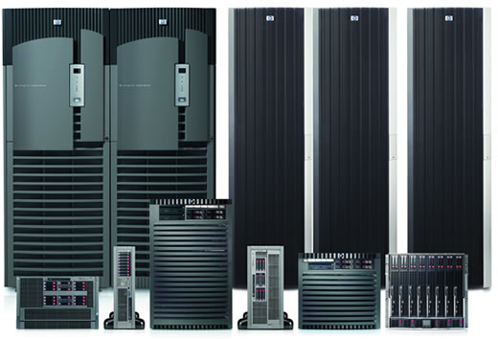
Bell Computers
Sales
ERP
Catalog
Catalog
Orders
Returns
CRM
Shipping

Slide 3


Slide 4
Bell.com design
Catalog
Account
Orders
Search

Slide 5
Bell.com reality
Catalog
Account
Orders
Search

Slide 6
Bell.com reality
Catalog
Account
Orders
Search

Slide 7
Bell.com by the numbers
15 years in production
Worldwide orders
Billions of $ per year in revenue
Millions of orders per day
But no way forward

Slide 8
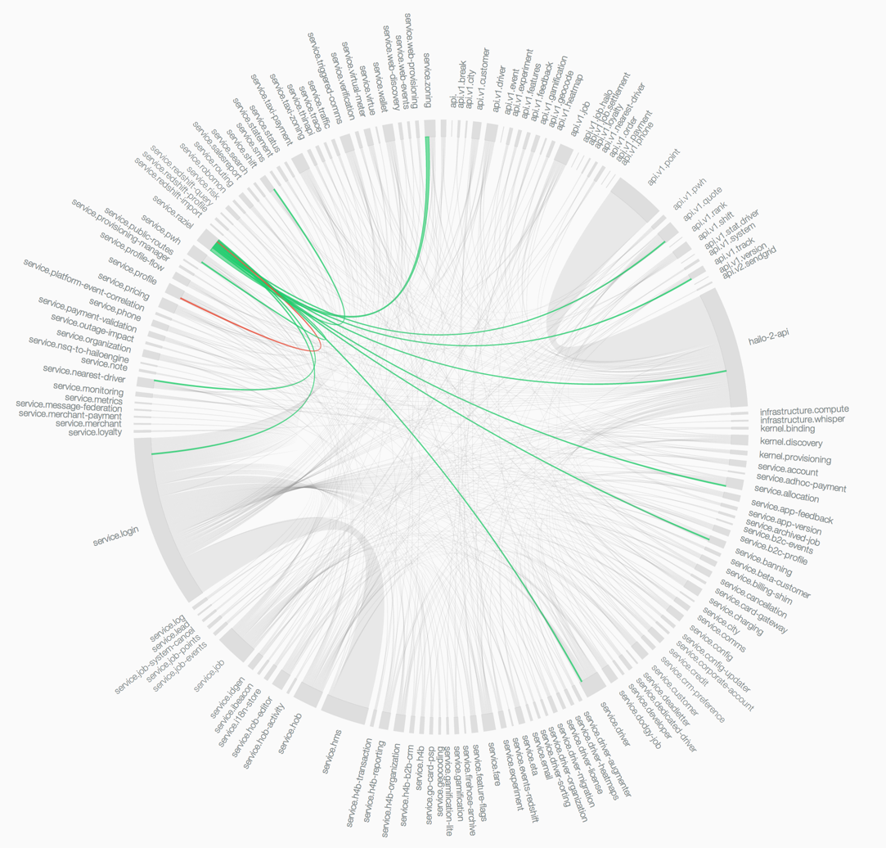
Netflix-oriented architecture

Slide 9
Core principles
No data duplication
Isolation and autonomy
Web APIs for everything
“Bell on Bell”

Slide 10
Pre-production go-live
18 months of effort
Hundreds of developers
Bell’s top hardware
… and nothing happened

Slide 11


Slide 12
API hell

Slide 13
Doing the math
Each API call SLA – 150ms, 99.9% uptime
200 * 150ms = 30sec
99.9% uptime * 200 calls = 0% availability
Doomed from the start

Slide 14
You own your SLA or your SLA owns you

Slide 15
“Immutability changes everything” – Pat Helland

Slide 16
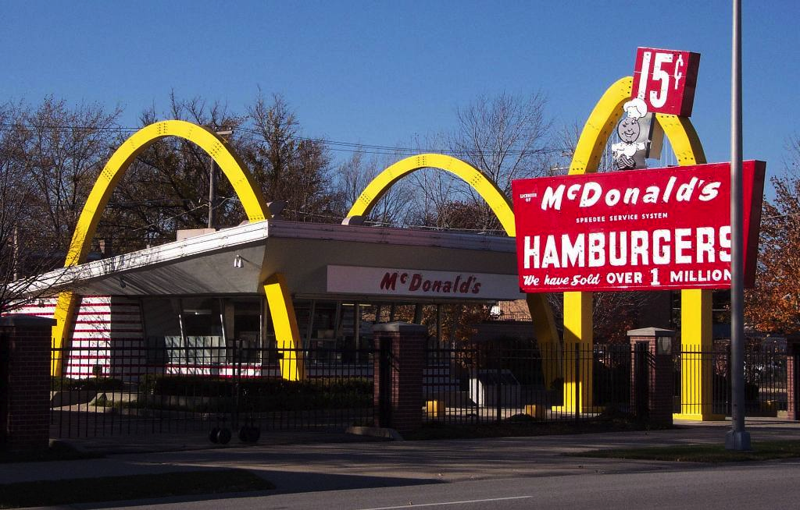
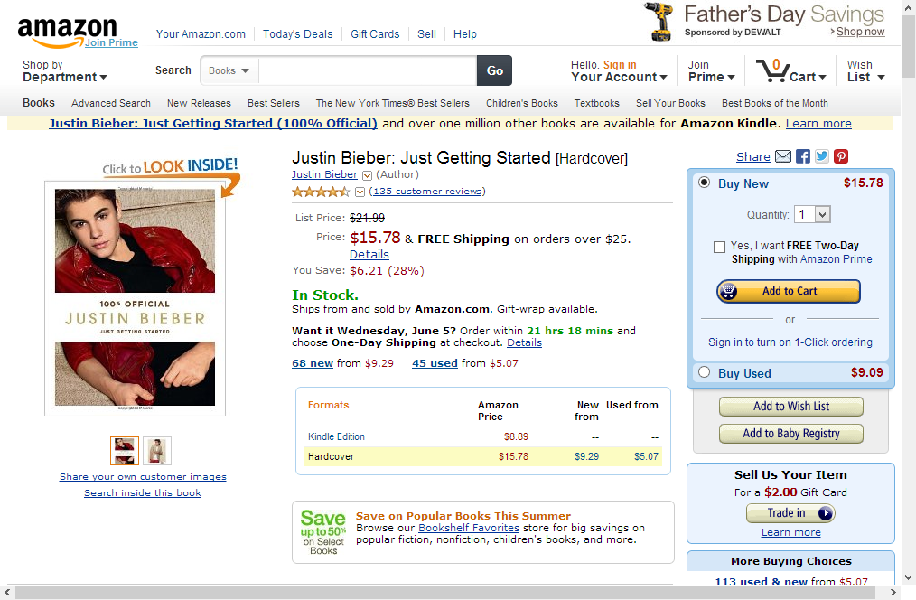


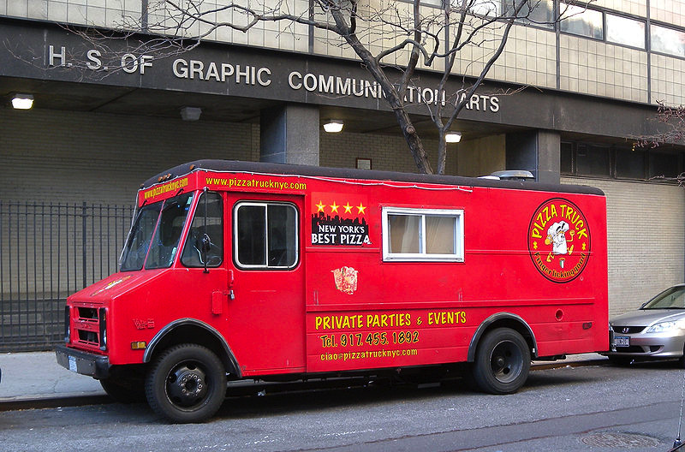
Grounding in reality

Slide 17
Catalogs and menus
Reading menu is cheap
Menu built for customers
Decisions on building menu not visible to customers
Dress
Grill
Pack
Menu

Slide 18
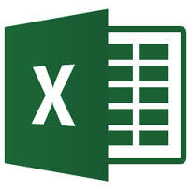

Creating the menu
Optimized for managing the menu
Decisions and business rules
Calculations and forecasts
Historical trends

Slide 19
Typical solution
Front end
Back
end
DB

Slide 20
Equivalent design
Same model to solve two very different problems
Two very different characteristics
Want two different solutions
Dress
Grill
Pack
wtf is going on in there

Slide 21
Better solution
Front end
Back
end
DB
DB
?

Slide 22
Interactions
Updating menu on a scheduled basis
Menu is immutable
Data is duplicated but ownership preserved
Dress
Grill
Pack
Menu

Slide 23
Publishing changes
PUBLISH MenuUpdated
{
“Date”: “2013-09-01”,
“Items”: [
{ “Name”: “Taco”,
“Price”: 1.49 },
…
]
}
Dress
Grill
Pack
Menu

Slide 24
Bell.com Search
Catalog
Pricing
search.bell.com
DocDB
Denormalizer
Localization
Content

Slide 25
Avoiding Microservice Megadisasters
Jimmy Bogard
@jbogard
github.com/jbogard
jimmybogard.lostechies.com
github.com/jbogard/presentations

